Slide 1
Caring for the Caregiver
Community Education Workshop:
CaringMatters & Montgomery County Public Schools
June 8, 2022
Judith R. Peres, LCSW-C

Slide 2
Objectives
Recognize caregivers
Recognize signs of caregiver stress
Recognize and honor the role of anticipatory grief
Identify helpful coping skills

Slide 3
Family & Friend Caregivers – You!
Any relative, partner, friend or neighbor who has a significant relationship with, and who provides a broad range of assistance for, an older person or an adult with a chronic or disabling condition.
The “average” U.S. caregiver is a 49-year-old woman who works and spends nearly 20 hours/week providing unpaid care to her mother for nearly 5 years.

Slide 4
Family & Friend Caregivers – You!
Serious illness or disability affects the family as well as the person
Most people with serious, chronic illness cannot manage their care on their own—they rely on their family/close friends
Family/friend caregivers are the “invisible workforce” in health and long-term care “systems”

Slide 5
Family & Friend Caregivers – You!
About 41 million family caregivers in the U.S. provide an estimated 34 billion hours of care to an adult with limitations in daily activities at any given point in time
The estimated economic value of their unpaid contributions was about $470 billion in 2017
Source: L. Feinberg, S.C. Reinhard, A. Houser, and R. Choula, Valuing the Invaluable: 2019 Update, The Growing Contributions and Costs of Family Caregiving (Washington, DC: AARP Public Policy Institute, November 2019)

Slide 6
Family & Friend Caregivers – You!
1 in 4 adults
More than 8 in 10 are caring for relative or friend age 50+
Predominantly female
31% care for 2 or more people
61% working

Slide 7
Family & Friend Caregivers – You!
Your choice
Perceived obligation
Attachment or relationship to the care recipient
Your proximity/ability to handle the situation
A child born with a birth defect

Slide 8
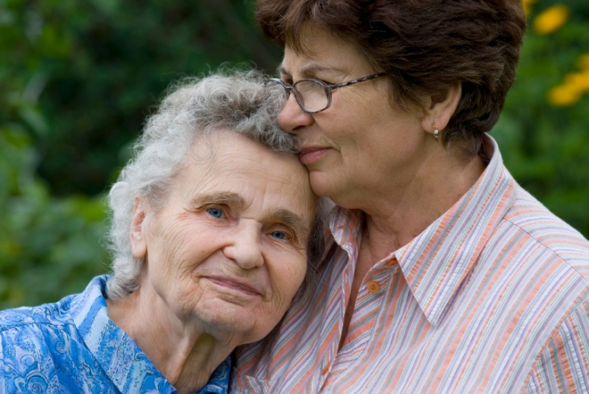
What’s Different About Caregiving Now than in the Past?
Changing composition of families & households
More long-distance caregiving
Increasing diversity
Delayed marriage and childbirth
High rates of divorce
Fewer adult children (smaller families)
Increasing numbers of childless women

Slide 9
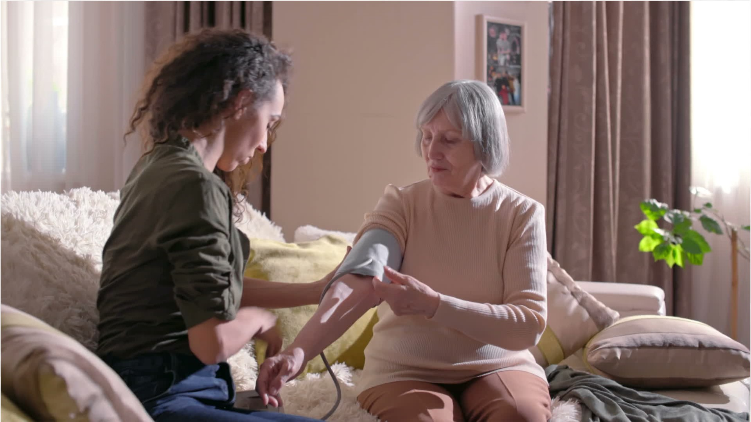
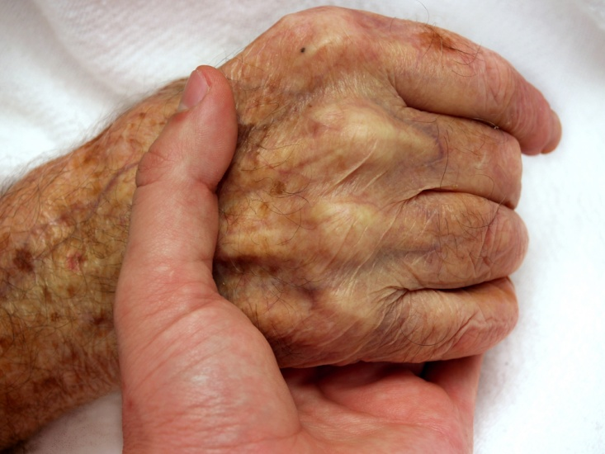
What’s Different About Caregiving Now Than in the Past?
Longer duration of caregiving
Greater complexity of family caregiving role
More women in the workplace
This Photo by Unknown Author is licensed under CC BY

Slide 10
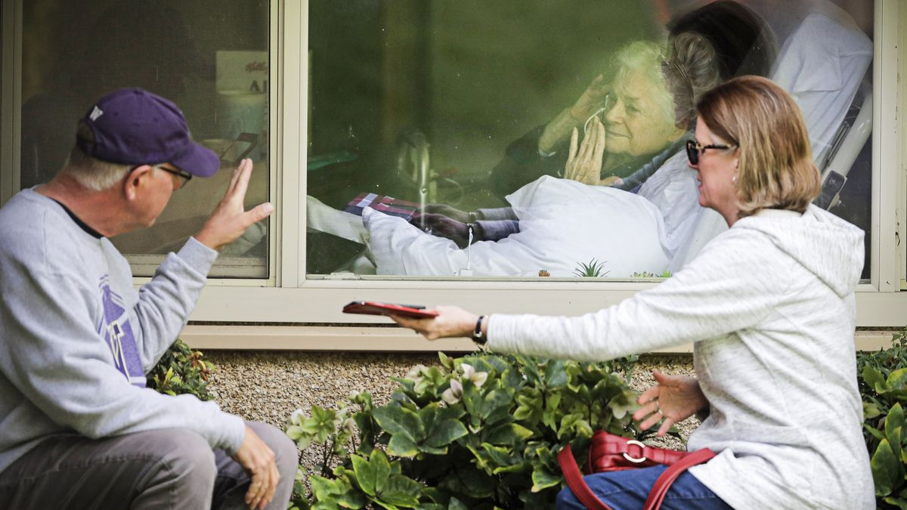

Slide 11
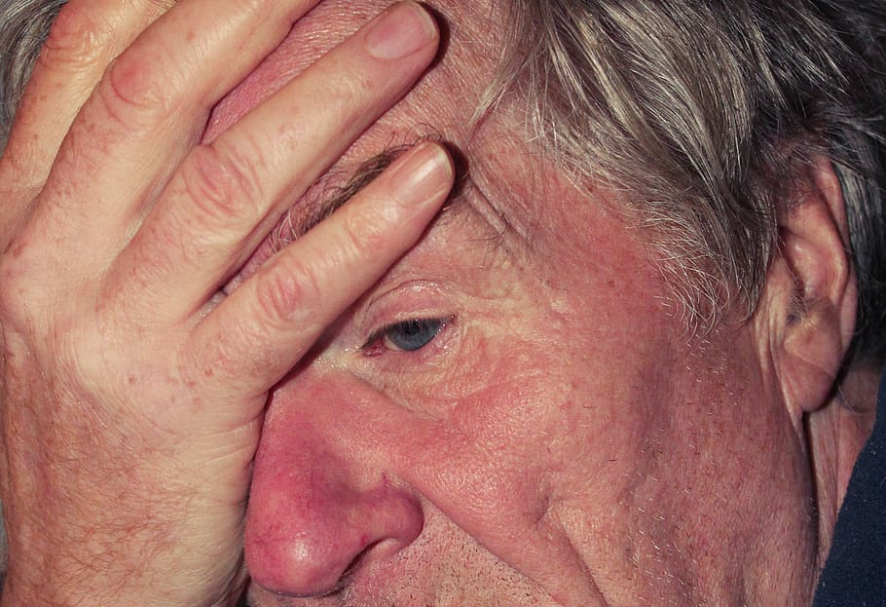
Signs and symptoms of caregiver stress
Withdrawing from friends & family
Losing interest in activities previously enjoyed
Feeling blue, irritable, hopeless and helpless
Experiencing changes in appetite, weight, or both

Slide 12
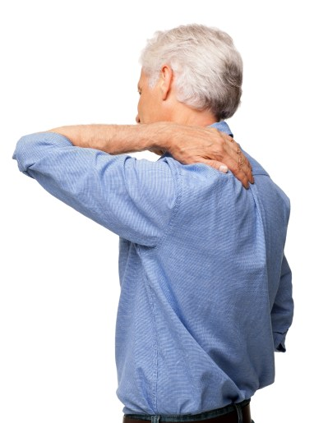
Signs and symptoms of caregiver stress
Experiencing changes in sleep patterns
Getting sick more often
Feeling you want to hurt yourself or the person for whom you are caring
Becoming emotionally and physically exhausted

Slide 13
Causes of caregiver stress
Physical and emotional components of care
Demands from care receiver & others in the environment
Apparent helplessness of the care receiver’s condition

Slide 14
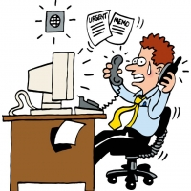
Causes of caregiver stress
Unreasonable expectations of your role
Role confusion
Conflicting policies and procedures when trying to access support services

Slide 15
Causes of caregiver stress
Grief& loss contribute to caregiver stress
Multiple losses experienced during illness
Grief-emotional response to loss
Caregiver grief considered:
Anticipatory
Ambiguous

Slide 16
The Symptom Experience of Grief
Physical discomfort
Sense of numbness
Feeling of detachment from others
Preoccupation with the care recipient
Guilt
Hostility
Disruption in daily schedule

Slide 17
Anticipatory and Preparatory Grief
Anticipatory grief (or mourning) is the grief an individual experiences before the death of someone close to them.
Preparatory grief is the grief that people who are dying go through.

Slide 18
Ambiguous Loss
In ambiguous loss, there is no verification of death or no certainty that the person will come back or return to the way they used to be.
Physically absent but psychologically present (e.g., MIA, kidnapping)
Physically present but psychologically absent (e.g., Alzheimer’s disease, TBI, addiction)
Unclear how one is to adapt
Confusing, baffling, immobilizing
Rituals are unavailable; little social support
Boss, P. (2009). Ambiguous loss: Learning to live with unresolved grief. Harvard University Press.
Waldrop, 2019.

Slide 19
Coping with caregiver stress
Positive Coping Style
Problem Solving
Relying on Social Support
Positive Outlook/Meaning
Negative Coping Style
Avoidance
Self Blame
“Magical” Thinking

Slide 20
Coping skills for caregivers Self-Care

Slide 21
Coping skills for caregivers Time Management
Make a daily “to do” list
Do the most important/difficult things first
Save up errands to do at once
Keep notebook
Create a “go bag”

Slide 22
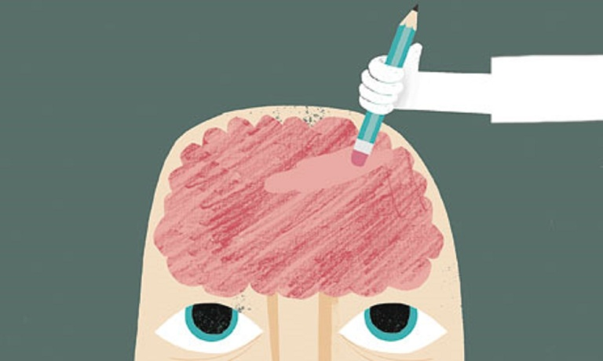
Coping skills for caregivers Time Management
Take along a small task if you go somewhere you know you will have to wait
Do an appraisal of the things you must do
Delegate what you can
Forget what is unnecessary

Slide 23
Coping skills for caregivers: Support
Take Care of Yourself First
Talk about your feelings & frustrations with someone you trust
Be realistic about your loved one’s disease.
Talk to a professional
Take advantage of respite care services
Know your limits

Slide 24
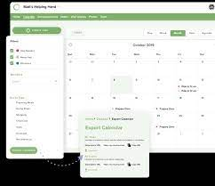
Coping skills for caregivers Support
Use technology for daily updates
Talk with your doctor and alert him/her to your caregiver status
Consider joining an online support group
Call a national hotline

Slide 25
Coping skills for caregivers Cognitive
Check Your Thinking
How we think affects how we feel and what we do
How we perceive a stressor impacts our level of stress
Become aware of how your thoughts are fueling your stress
Ask yourself:
1) What am I thinking?
2) What am I telling myself about the caregiving?
3) How would I advise a friend in the same situation?

Slide 26
Coping skills for caregivers Cognitive
To reduce negative thoughts:
Set aside a time every day to write about the person
Use thought stopping techniques (snapping an elastic band on your wrist, popping bubble wrap)
Distraction (turn up lively music for a short time)
Practice Mindfulness (preoccupation or distress can lead to accidents)

Slide 27
Coping skills for caregivers “Spiritual”
Progressive relaxation
Yoga
Meditation
Pray
Connect with Nature

Slide 28
Coping skills for caregivers Meditation
Meditation Apps
10-20 minutes of meditation, twice a day leads to:
decreased metabolism
decreased heart rate
decreased breathing
slower brain waves
Relaxation Response Benson, H. et.al.

Slide 29
Coping skills for caregivers Grounding

Slide 30
Resources
General resources caregivers
Aging Life Care Association (formerly the National Association of Professional Geriatric Care Managers) www.aginglifecare.org
CaringMatters
www.caringmatters.org
Eldercare Locator eldercare.acl.gov
Family Caregiver Alliance www.caregiver.org
Medicare and Medicaid www.cms.gov
Meals on Wheels America www.mealsonwheelsamerica.org
National Adult Day Services Association www.nadsa.org
National Hospice and Palliative Care Organization www.nhpco.org

